Slide 1

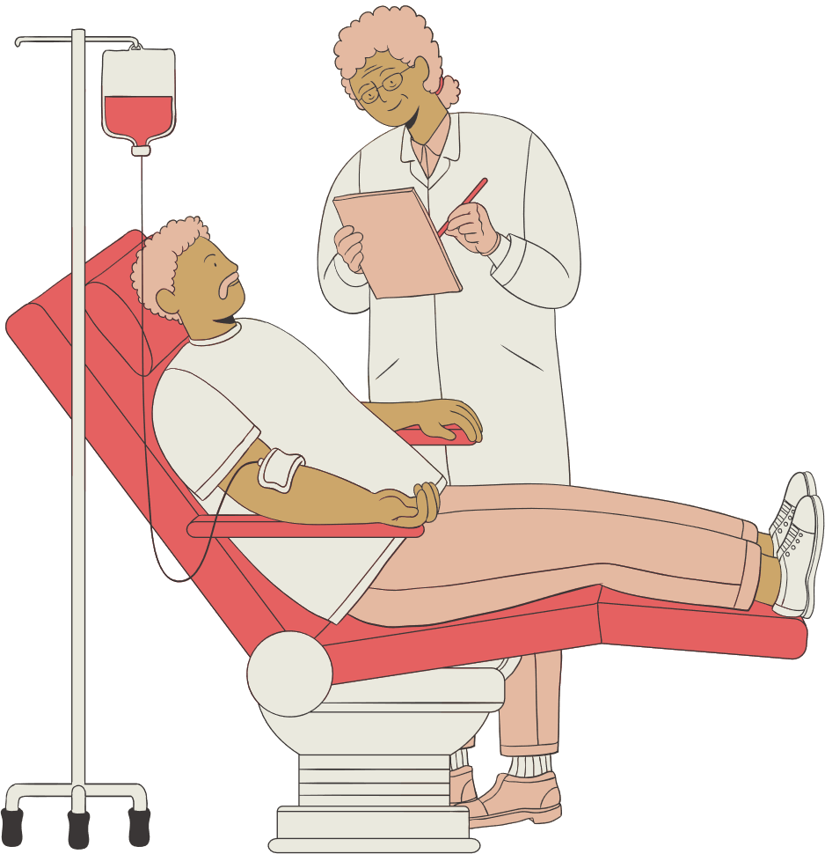
Overview 01
Overview 02
Overview 03
Live location tracking
Collaborations with hospitals and blood banks
pick-up and drop-in facility
BLOOD CONNECT
~save your soul
Objective
To bridge the gap between blood donors and the recipients, thus facilitating timely blood services in a efficient and effective way.

Slide 2
PROBLEM STATEMENT
People in urgent need of blood struggle
to find compatible donors quickly due to the absence of a real-time, accessible, and efficient connection platform.
This delay in blood availability can be life-threatening.

Slide 3



sample Interface-
home page

Slide 4
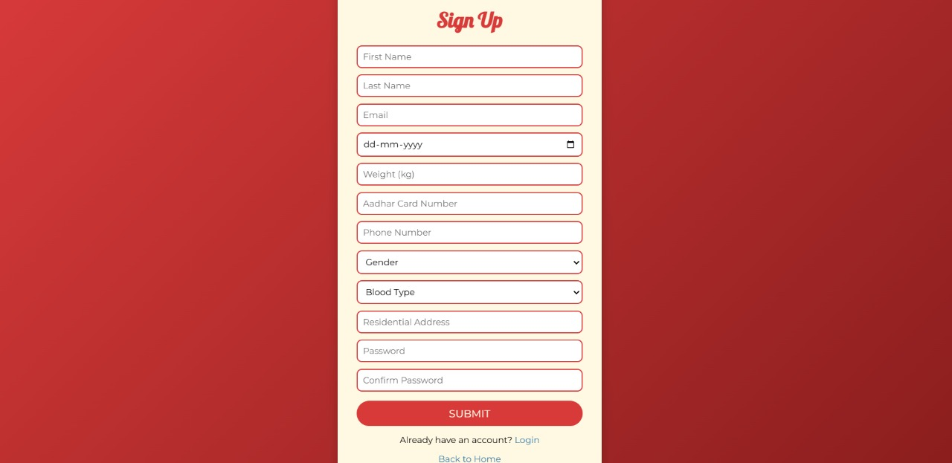
sample Interface-
register page

Slide 5
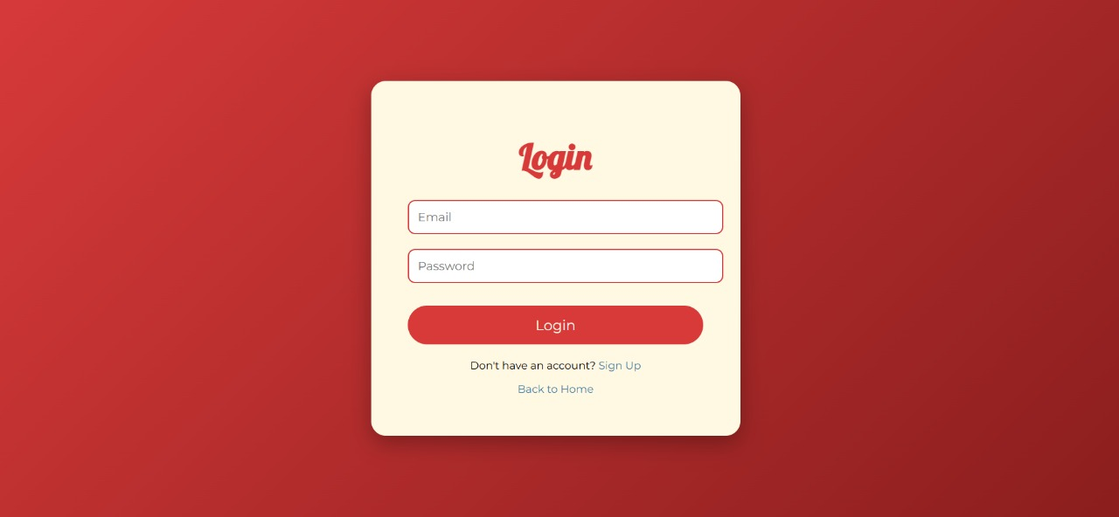
Sample interface –
Login page

Slide 6
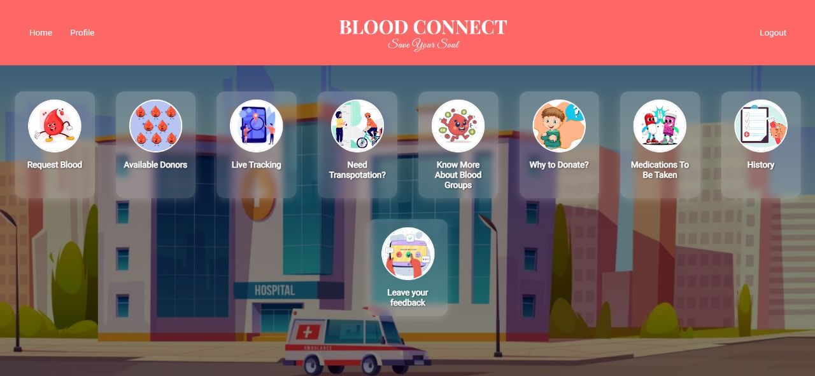
Sample interface –
Features

Slide 7
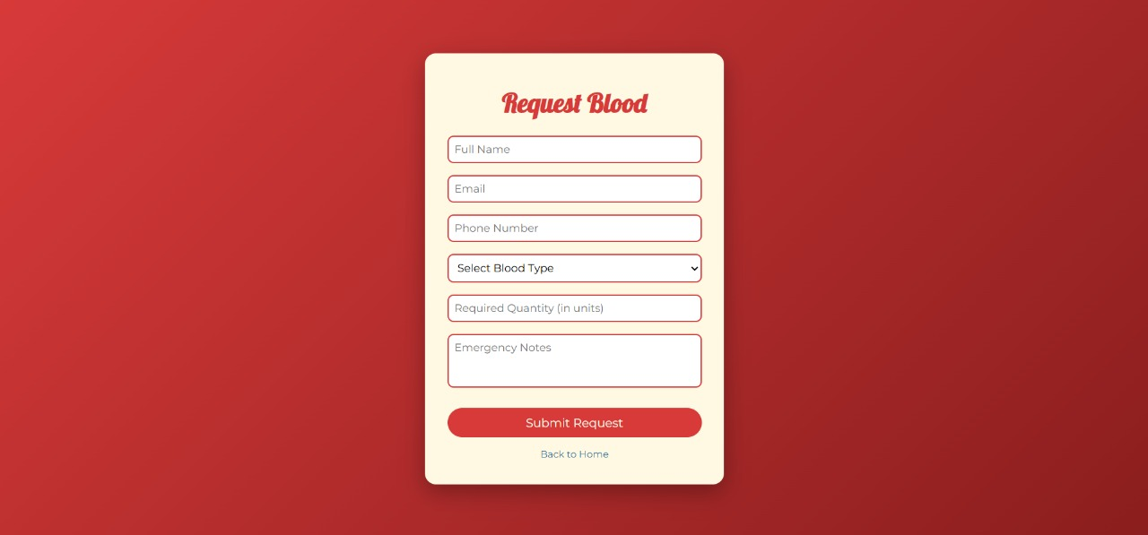
Request Blood

Slide 8
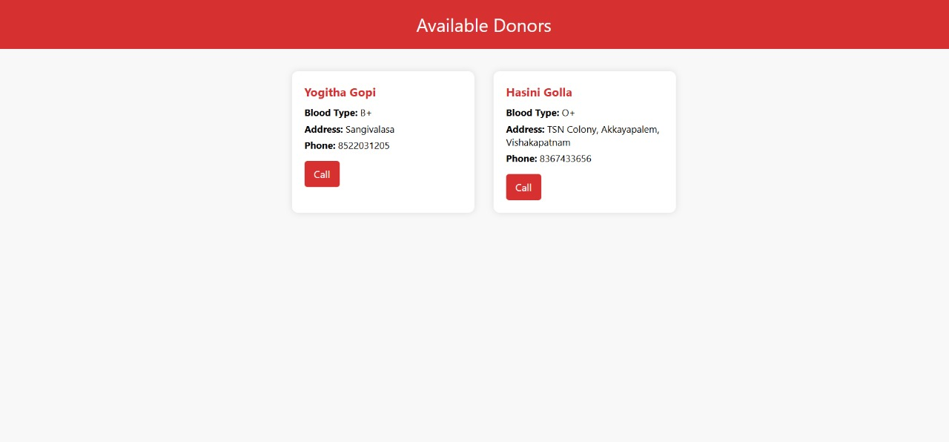
Available Donors

Slide 9
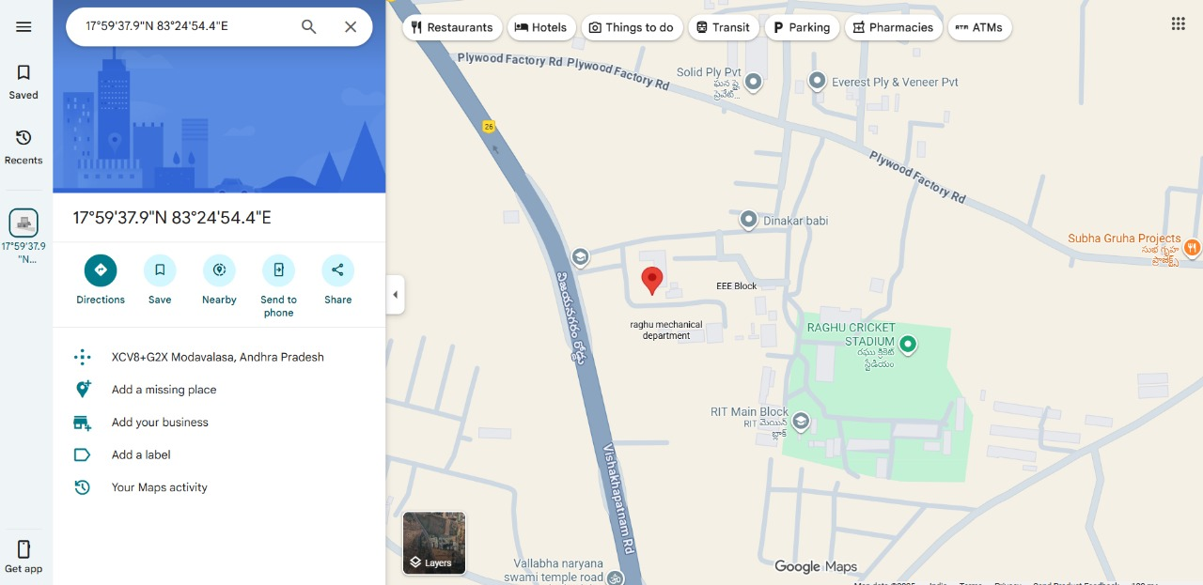
Live Tracking

Slide 10
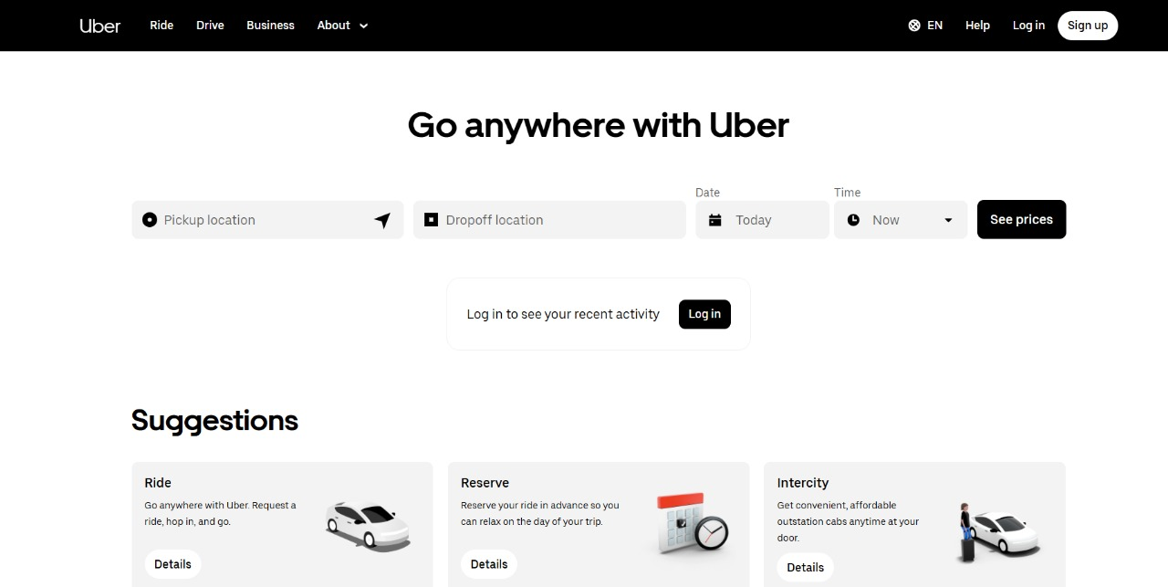
Transportation need

Slide 11
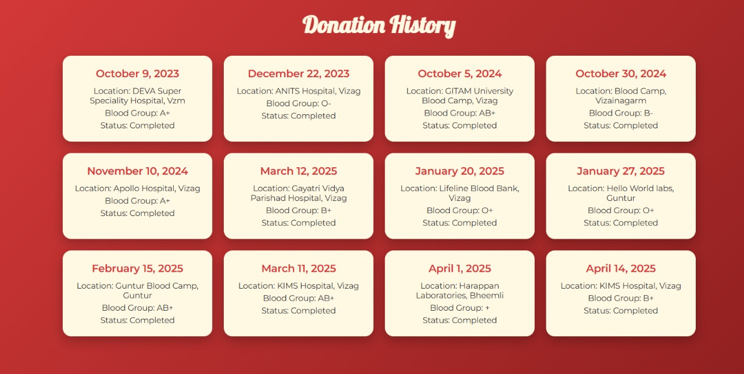
Donation History

Slide 12
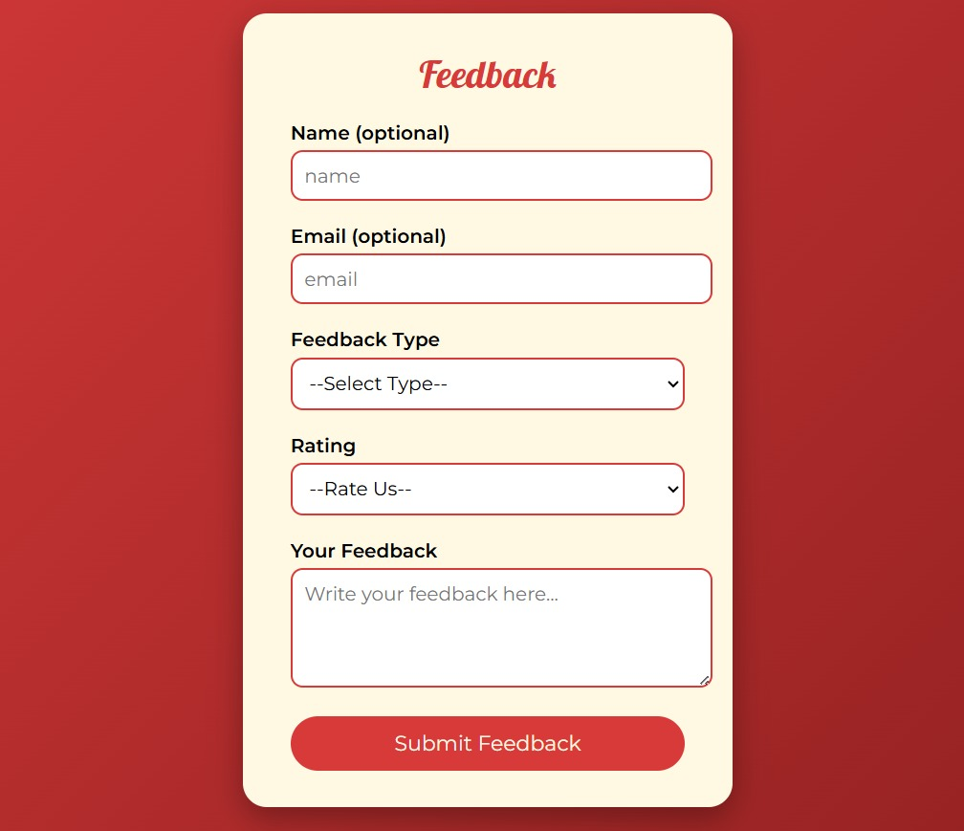
Feedback

Slide 13


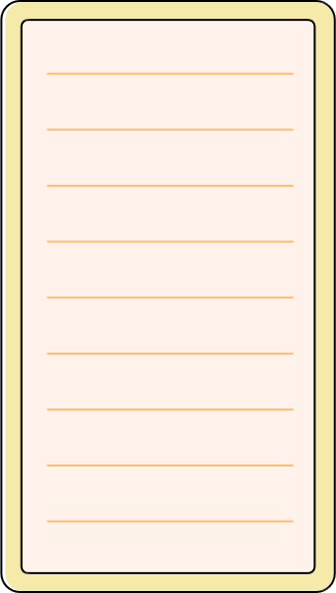


THANK YOU

